Slide 1
2023 Board of Directors Meeting
November 9, 2023

Slide 2
Agenda
1. Introductions
2. Ratification of Minutes and Subsequent Written Consents (Attached)
3. Financial Report: Investment of Funds in Bonds, T-Bills, and Money Markets (Attached)
4. Election of Officers (Vote Required)
5. Discussion of Upcoming Activities at Moorefield and the Conservancy
a. Metro Walk Rec Center Completion
b. Grandmoore Park Construction and Trails (New Logo and Signs)
c. Brambleton’s Construction of Centergate Drive, Charitable Street, Loudoun County Parkway Regional Trail, and Landscaping
d. Sale Pending to Aventon (E-8) (Show Elevations)
e. Lease Agreement with Dash-In on D-2
f. Sidewalks, Snow, Ice, and General Maintenance
g. Traffic Signal at Claude Moore Drive and Loudoun County Parkway
h. On-going Landscaping Responsibility (trees and mowing)
6. 2024 Budget/Assessments (Vote Required) (Attached)
7. Sub-association reports
8. Q&A limited to Agenda Topics
9. Other business

Slide 3
2023 Board of directors
CLASS A DIRECTOR: Keila Fox
Community Planning Manager, DC Metro
Toll Brothers
CLASS B DIRECTOR: John Troy
Vice President
Sirhandi Companies
CLASS C DIRECTOR: Ron Snyder
Director of Land Development
ATAPCO
CLASS D DIRECTOR: Rosemarie Linder
Brambleton
CLASS E DIRECTORS: Marc A. Brown
Claude Moore Charitable Foundation
Guy M. Gravett
Claude Moore Charitable Foundation
Gale L. Morgan
Claude Moore Charitable Foundation
Jack Vega
Claude Moore Charitable Foundation
Sergio Chávez
Claude Moore Charitable Foundation
2024 PROPOSED OFFICERS
President: Marc A. Brown
Treasurer: Marc A. Brown
Secretary: Jack Vega

Slide 4
Metro walk rec center completion

Slide 5
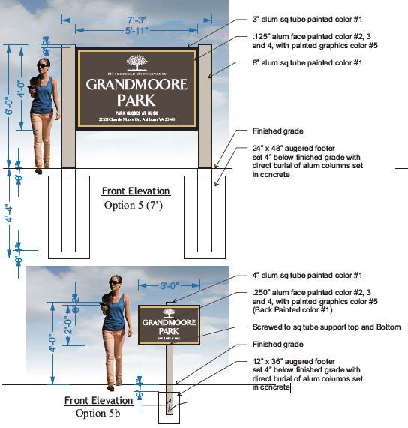
Grandmoore park & Trails

Slide 6
Brambleton Construction

Slide 7
Landscaping responsibility

Slide 9
Sale pending to aventon

Slide 10
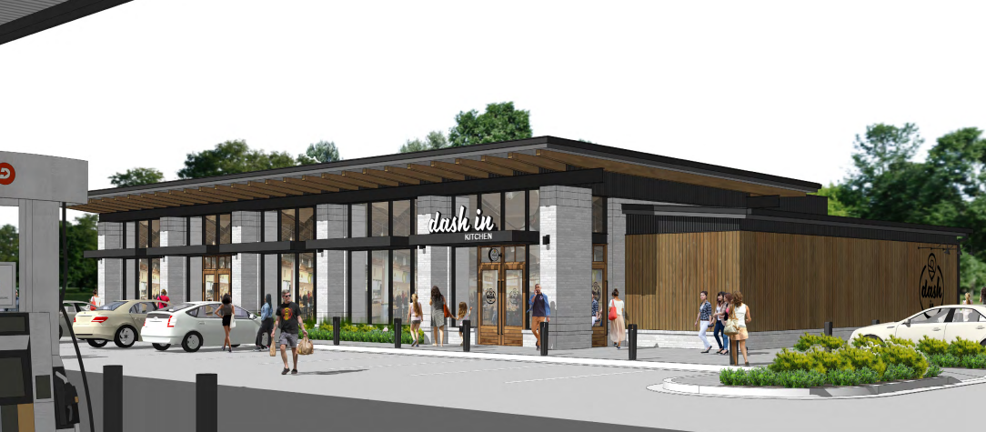
Lease agreement with dash-in

Slide 12
Traffic signal at claude moore drive & Loudoun County Parkway

Slide 13
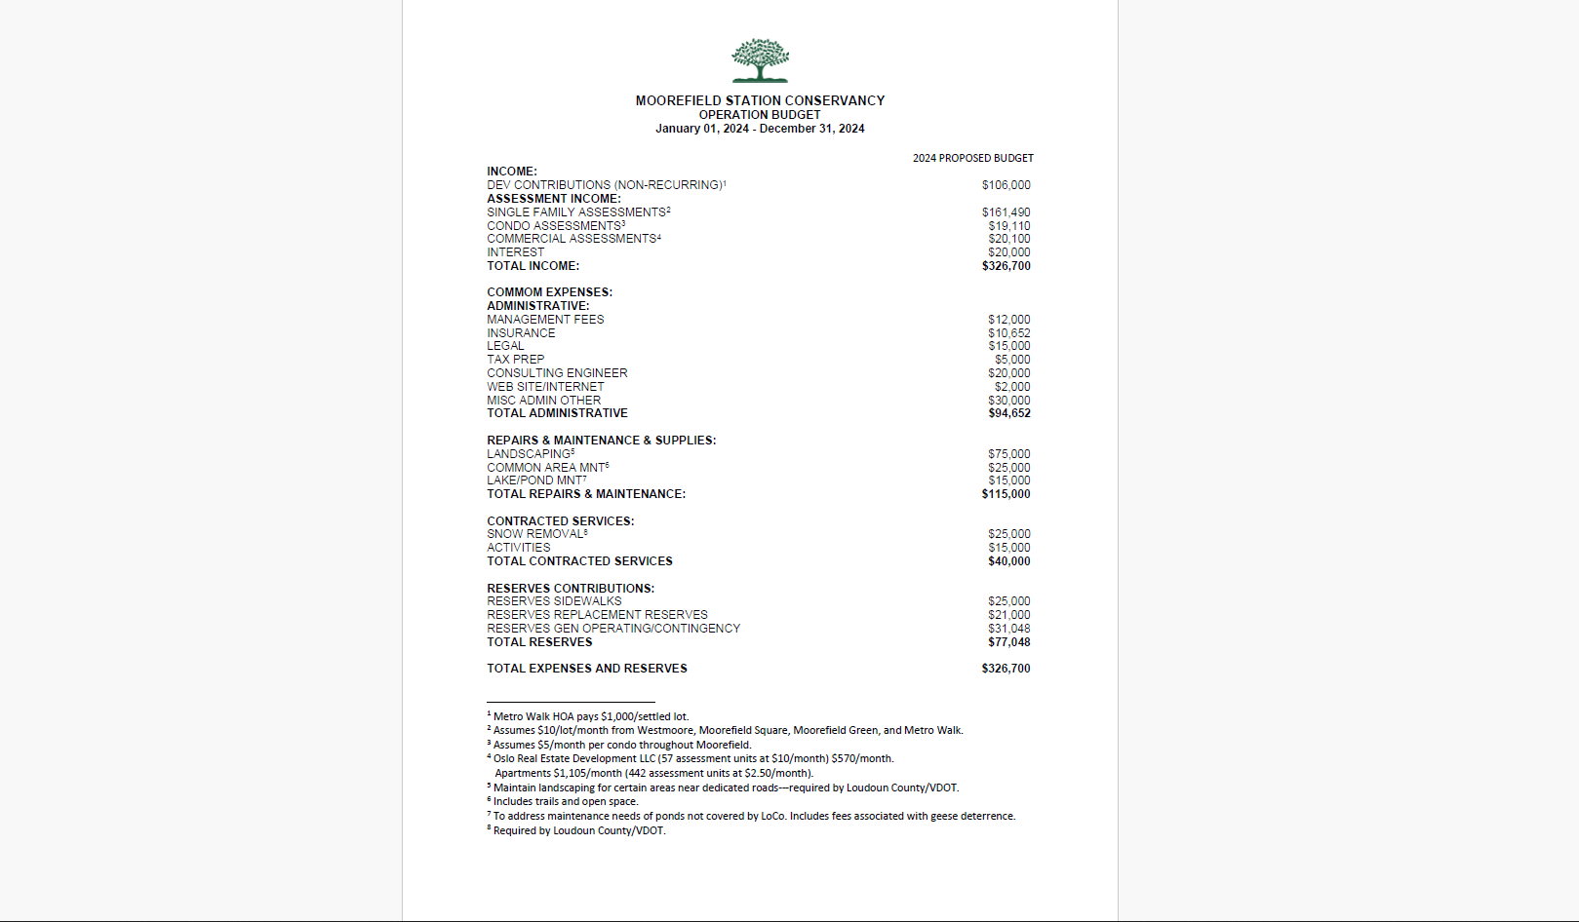

Slide 14
2023 Moorefield Station Conservancy
Board of Directors Meeting
November 9, 2023
THANK YOU!
Q&A

